Slide 1


Introducing the
PGS Digital Service
March 2021

Slide 2
What is the PGS?
The Parish Giving Scheme (PGS) is a
simple and secure way for churches to
receive regular donations.
We exist in order to enhance the generosity that enriches the Church of England’s
ministry in each community.

Slide 3
What is the PGS?
Already trusted as the giving method of choice by
more than 55,000 donors,
to almost 3,300 parishes,
across 30 dioceses
We are committed to empowering all generations to give with confidence and to feel valued, while easing the administrative burden for churches.

Slide 4
So, what is the
PGS Digital Service?
We’ve brought a few processes online, to make things even more simple and secure for parishes and donors.
From 1 March 2021, on our website:
New donors can set up a regular donation
Statement Receivers can view their parish statements
Coming very soon…
Existing donors will be able to update their gift and preferences
We call this our digital service.

Slide 5

Making it easy:
The giving journey
for donors

Slide 6
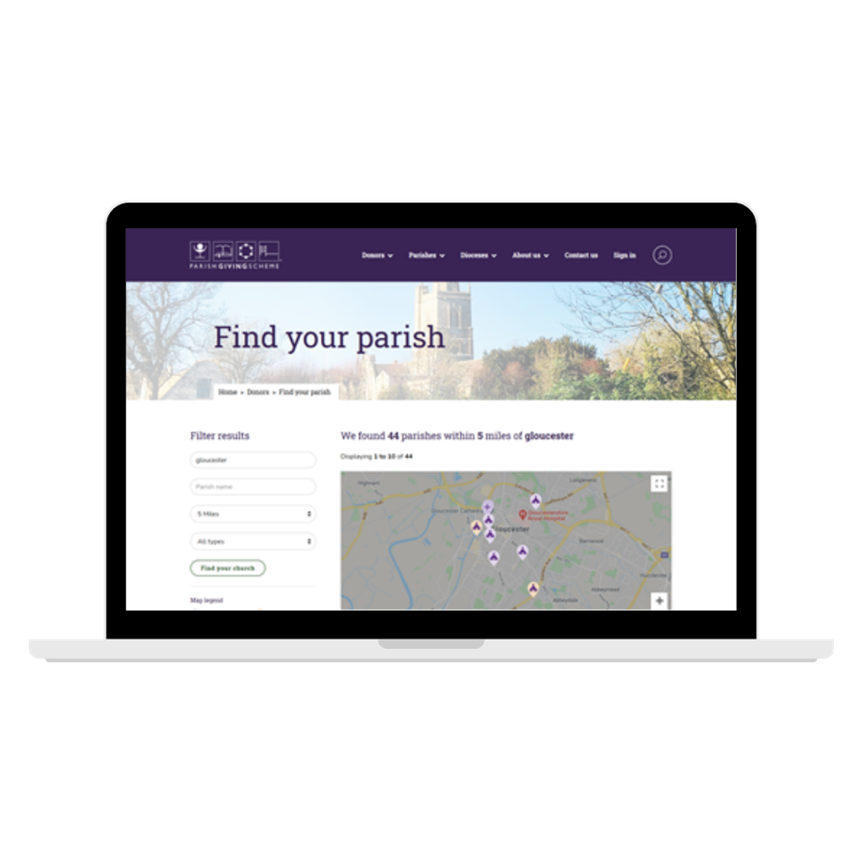
Steps to online giving
Anyone choosing to donate via PGS for the first time can do so on parishgiving.org.uk in just three steps:
Find their church – either by using the ‘search tool’ or scanning the QR code provided by their parish

Slide 7
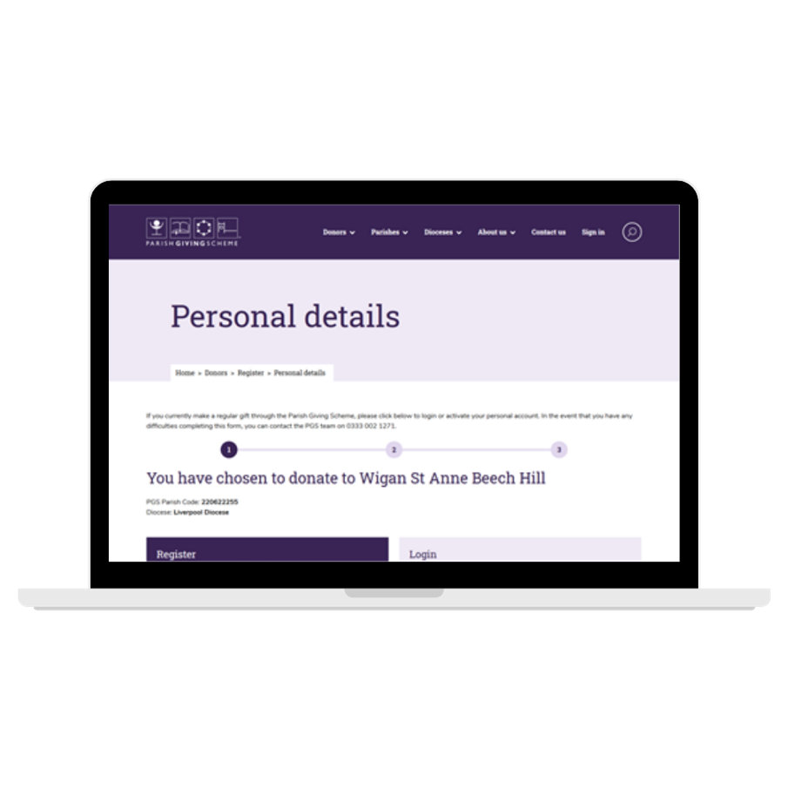
Steps to online giving
Register for a PGS online account – giving them secure personal access

Slide 8
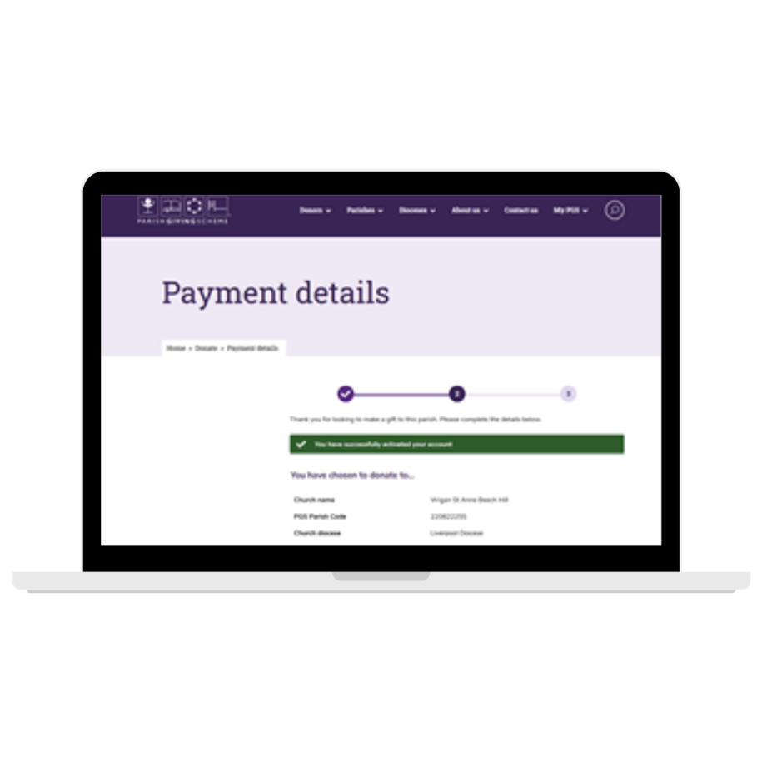
Steps to online giving
Set up a Direct Debit instruction – with options to add Gift Aid and increase their gift annually in line with inflation

Slide 9
Making it easy:
Support for
Statement Receivers
& parish administrators

Slide 10
Viewing monthly statements
Many Statement Receivers are already making good use of this service – it’s quick to do and cuts down on paperwork:
Register for a PGS online account – giving secure personal access to your parish reports

Slide 11
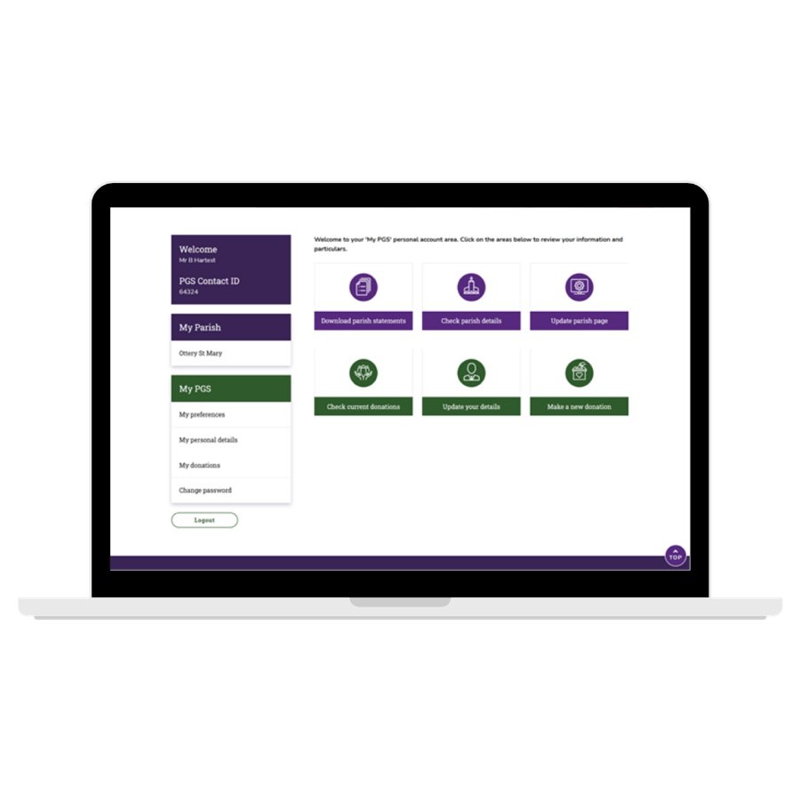
Viewing monthly statements
View anytime – we upload your parish statements monthly, building up a rolling 12-month archive
Adding administrators – personal log-ins should never be shared, for security reasons. But you can easily add new administrators by calling the PGS team on 0333 002 1260

Slide 12
Helping you to prepare
As parishes prepare to introduce online giving services to donors, there are a few important things to think about:
Every PGS-registered parish has its own landing page on the PGS website, where donors begin their giving journey
Many parishes manage donations on behalf of multiple churches. This is true for donations made online too
It’s important that the parish makes it clear which churches’ donations they manage – this reassures the donor that their gift is being directed towards their chosen church, even if the parish name is different. We will show you where you add this message on your parish landing page
Consider your messages – while this is a new method of giving, it’s not the only one. Reassure people that they can still donate via phone or post
You choose the timing – we understand that it’s helpful to build this into a wider message at the heart of your ministry. The timing for ‘launch’ of the online service is at your discretion, once the services are live

Slide 13
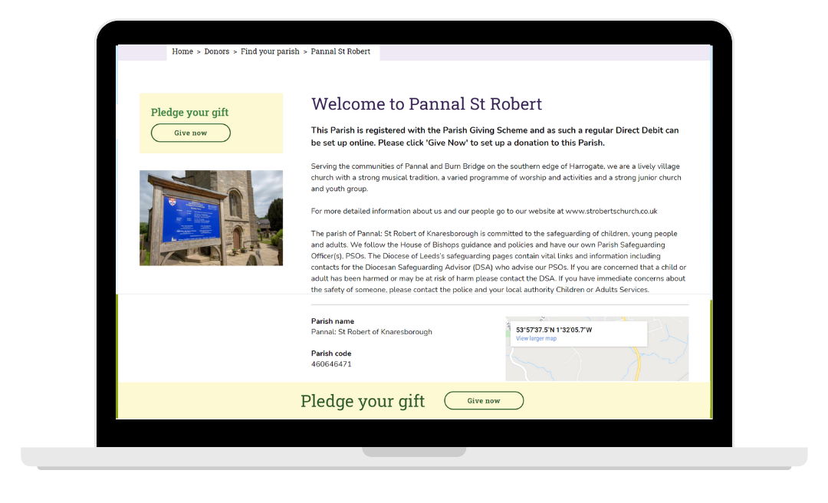
Editing your parish landing page
Every parish that’s registered in the PGS scheme can edit its own page on the PGS website.

Slide 14
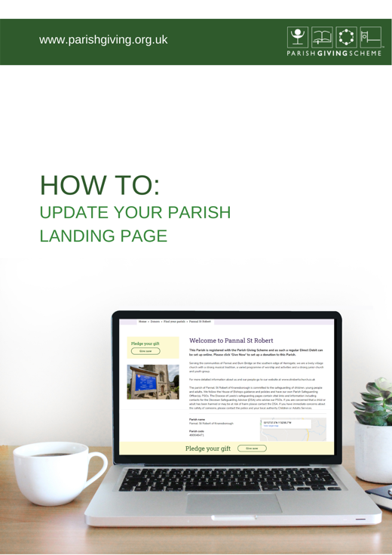
Editing your parish landing page
The key features are:
Parish control – the information on the page is synchronised with what you choose to publish on the A Church Near You website (eg. church contact details) plus a personalised introduction that you can write and edit on the PGS site
Secure and easy to access – parish administrators will find the ‘edit your page’ button when they log in
We have prepared a step-by-step guide to assist parishes.

Slide 15

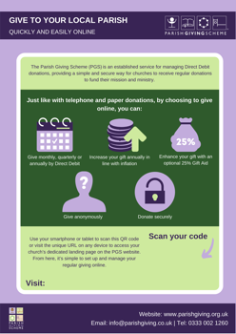
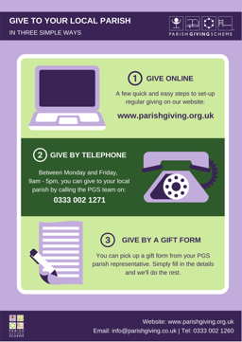
Helping you to inform donors
We have prepared the following resources for parishes, that are suitable for sharing with members of your church community:
Step-by-step guide for donors – a visual walk-through of the online donor journey, in a pdf document
Poster template – with instructions to easily add your QR code and URL address for the parish landing page
Infographic – an illustration of the ‘3 ways to give’, which you may like to drop in to your own materials

Slide 16
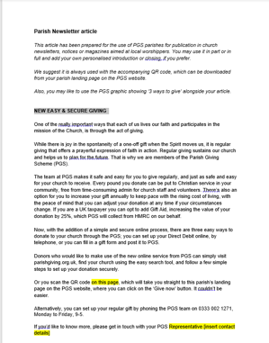
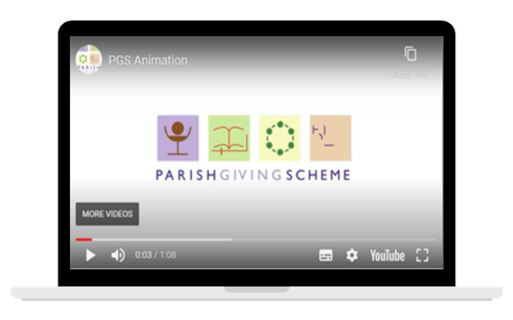
Helping you to inform donors
Sample newsletter story – that you can edit, adapt and use freely
Animation – coming soon! To coincide with the services to existing donors going live online, we will share a short video informing donors of ‘3 ways to give’, for use on church websites or social media feeds

Slide 17
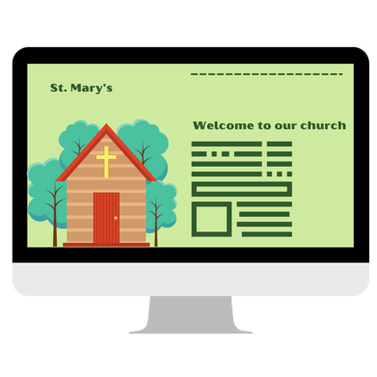
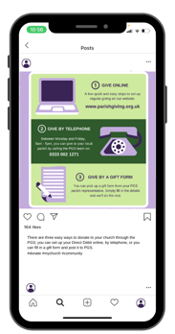
Best practice comms
There are lots of ways to make use of the resources provided and encourage donors to give regularly – and to review their giving too.
Taking your message online is a great opportunity to talk about the ease of donating simply and safely with PGS
Where can you add your URL or QR code so that people can easily link to the PGS website?
  Church websites
  A Church Near You (ACNY)
  Social media posts – add the URL within a ’call to action’ if you are posting about giving, or the positive impacts that regular giving brings to your community

Slide 18
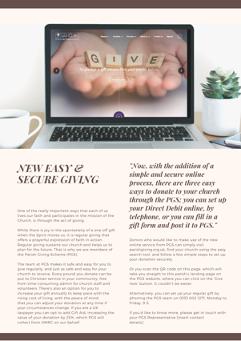

Best practice comms
You could also reach parishioners and donors as part of a range of regular activities, such as:
Parish magazine
Weekly bulletins
Appeal letters
Orders of service
Online worship
Email
Text
Posters
Banners

Slide 19
In summary
Now, there are
three ways to give
We understand that donors appreciate choice, which is why you’ll see ‘3 ways to give’ repeated in our messaging; online, by phone, by post.
Each method is simple and secure.
What’s more, every pound gifted goes to support their church’s mission and ministry, with no donor fees or charges to parishes.

Slide 20
Thank you
We would like to say a big ‘thank you’ to the five dioceses and their parishes who participated in the pilot for our digital services.
Our sincere thanks too, to every one of our member dioceses and parishes, for choosing to be part of the PGS Family.

Slide 21
Your diocese contact:
Name
Email
Tel

